Slide 1
M
M
M
16.
16.
16.

Slide 2



Slide 3

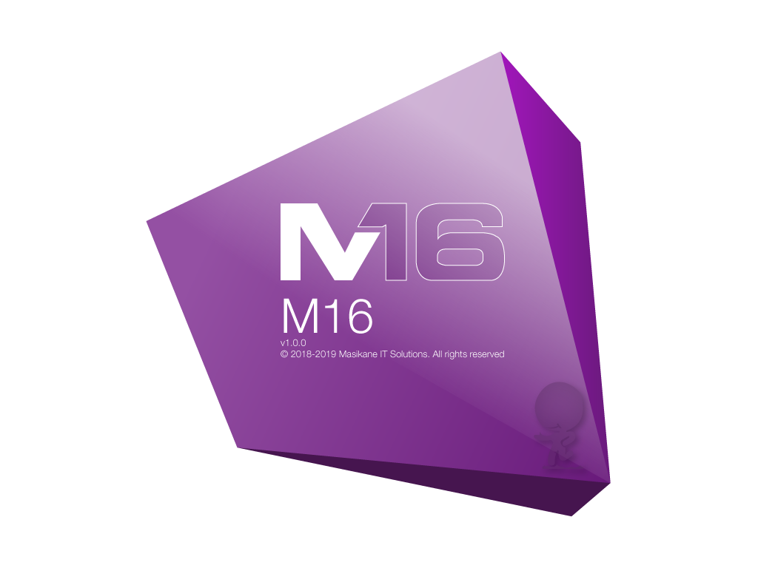
Introduction
We would like to welcome everybody to M16 Interior POS – Software for the internet café’s. whereby we the Masikane IT Solutions (PTY) LTD Company has being checking at other Internet cafes surrounding Soweto. Whether how do they operate within their Internet cafes when coming to the pricing of their products and services.
M16 Interior POS – Internet Café point of sale software is not like the other software specially designed for monitoring the systems of any internet cafes. M16 – is designed to perform sales operated at the Internet cafes. Of which it is an software meant to assist the cashier during the services of every day.

Slide 4
M16 INTERIOR POS AT THE COST OF R350.00
This version of M16 will be given for free for a BETA testing with users.
This version will be Version 2 the main one which will be developed from the first version as given out for testing with users.
Only for
R350.00
R75.00 For maintenance when needed

Slide 5
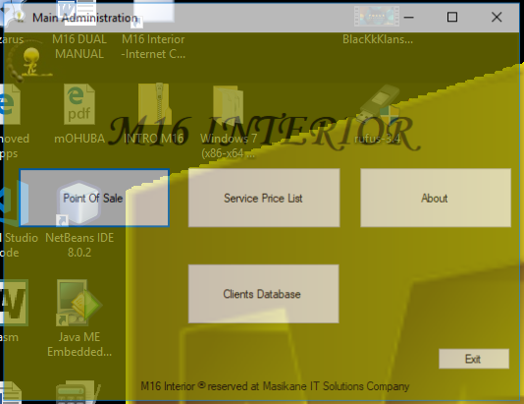
M16 INTERIOR ADMINISTRATION INTERFACE

Slide 6
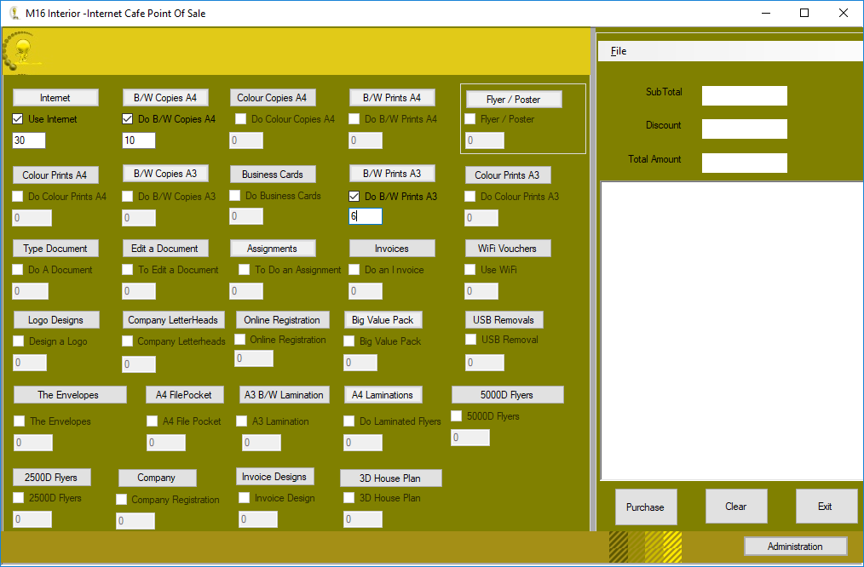
M16 INTERIOR POINT OF SALE INTERFACE

Slide 7
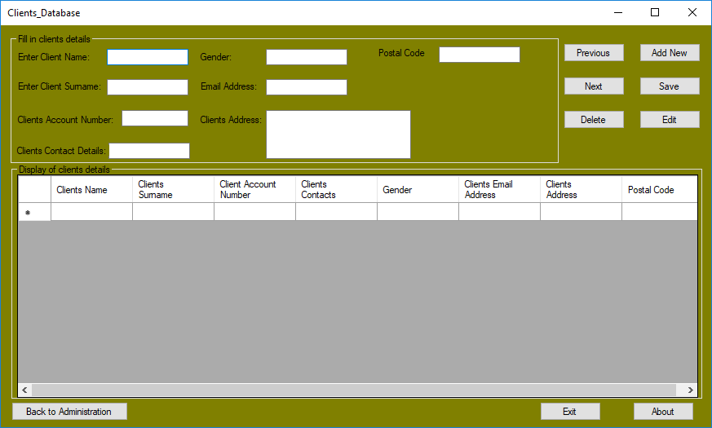
M16 INTERIOR CLIENTS_DATABASE INTERFACE

Slide 8
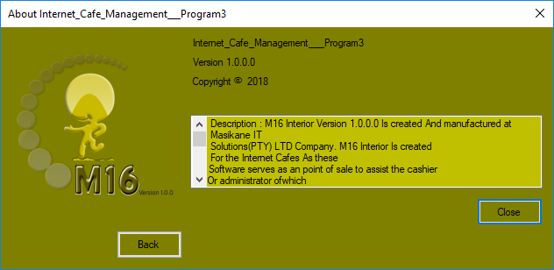
M16 INTERIOR ABOUT INTERNET_CAFE_MANAGEMENT INTERFACE

Slide 9
The existence of M16 Interior POS Version 1.0.0
The internet cafes might have some different software’s more like Pastel, Express Accounts and True café but the difference between M16 and those above-mentioned software’s. M16 its that it can only perform sales at this current version of this software whereby as time goes M16 Interior will be developed to the next higher versions. As the end users of this software they will be helping us to integrate them according to their prospects views and possible feedbacks. It will be an advantage to witness any operations/ activities performed by the cashier.

Slide 10
The making and the rescue of M16 Interior V1
M16 Interior manufactured by (MIT) Masikane IT Solutions (Software Department) and in the later stage after it’s SDLC Approach got completed it then happened that (HOS) Hypothetical Objective Systems Inc. (PTY) it assigned (ISDF) Individual Software Developers Forum to run some of the software maintenance on M16 Interior POS. The MIT Software development team is currently working on the planning of the next version of M16 Exterior POS version 2.
M16 POS existence began in 23 April 2018 due to the worries of some Internet café owners not feeling secured when leaving their staff behind with business. So there is proof requested from the business owners at the end of the day regardless of some styles of doing readings based on the sales and services offered.
“M16 Interior POS – Purpose of M16 Interior - POS".

Slide 11

Get In Touch
386 Phillip Enoch Street, Mmesi Park, Dobsonville,
Roodepoort South
Gauteng, 1863
+27 (0) 62 58 10101
mosa@masikanesolutions.co.za
Princevxiii.mosamoabi@programmer.net

Slide 12


thank you a lot for your support by

